Slide 1
COVID-19
A local COVID-19-centric website
https://youtu.be/F6Ah7pUNRFE

Slide 2
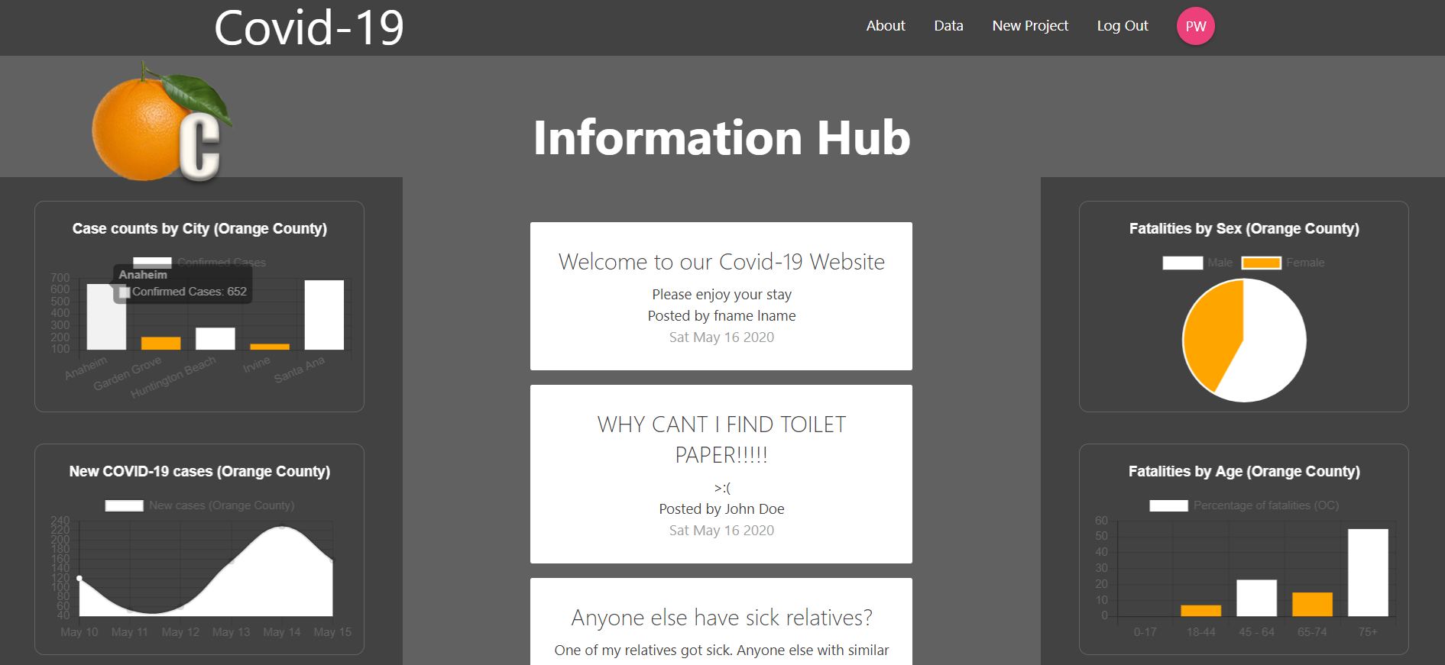
Homepage

Slide 3
Graphs and Charts
Data :
Obtained from OC Health Care Agency’s COVID-19 website https://occovid19.ochealthinfo.com/coronavirus-in-oc
Libraries:
CanvasJS: JavaScrip and HTML5 library
ChartsJS: JavaScript library for data visualization

Slide 4
What are we showing on the charts?
Only Orange County data:
Case counts by city
New cases by day
Patients requiring hospital care by day
Distribution of male and female fatalities
Distribution of fatalities by age group
Distribution of fatalities by ethnicity

Slide 5
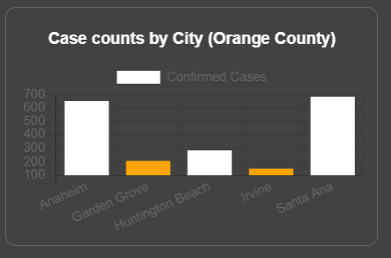
Case counts by City
Chart type: Bar chart
Cities:
Anaheim
Garden Grove
Huntington Beach
Irvine
Santa Ana

Slide 6
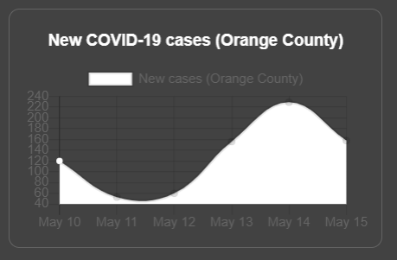
Newly reported COVID-19 cases by day
Chart type: Line Chart
X-axis: Last five days
Y-axis: Number of reported cases

Slide 7
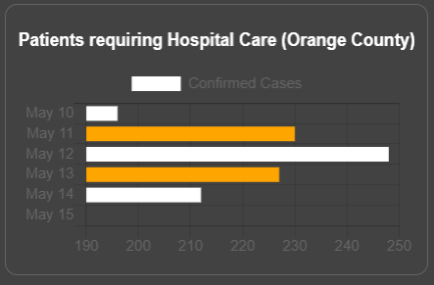
Patients requiring hospital care by day
Chart type: Stacked bar chart
X-axis: Number of reported cases
Y-axis: Previous five days

Slide 8
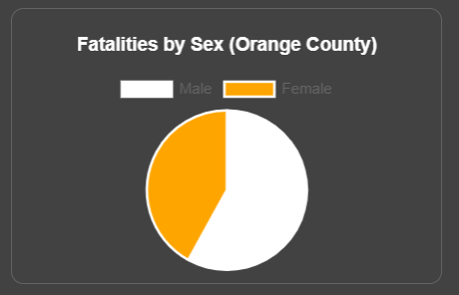
Distribution of Male/Female fatalities in OC
Chart type: Pie Chart
% of Male fatalities: White
% of Female fatalities: Orange

Slide 9
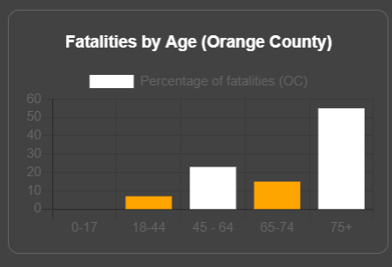
Distribution of fatalities by age group
Chart type: Bar chart
Age groups:
0 - 17
18 - 44
45 - 64
65 - 74
75+

Slide 10

SignUp/Login
Authentication and storing user information is all handled by firebase.
I used material design framework(created by google) to design the layout of the signup, login, and user posts.

Slide 11
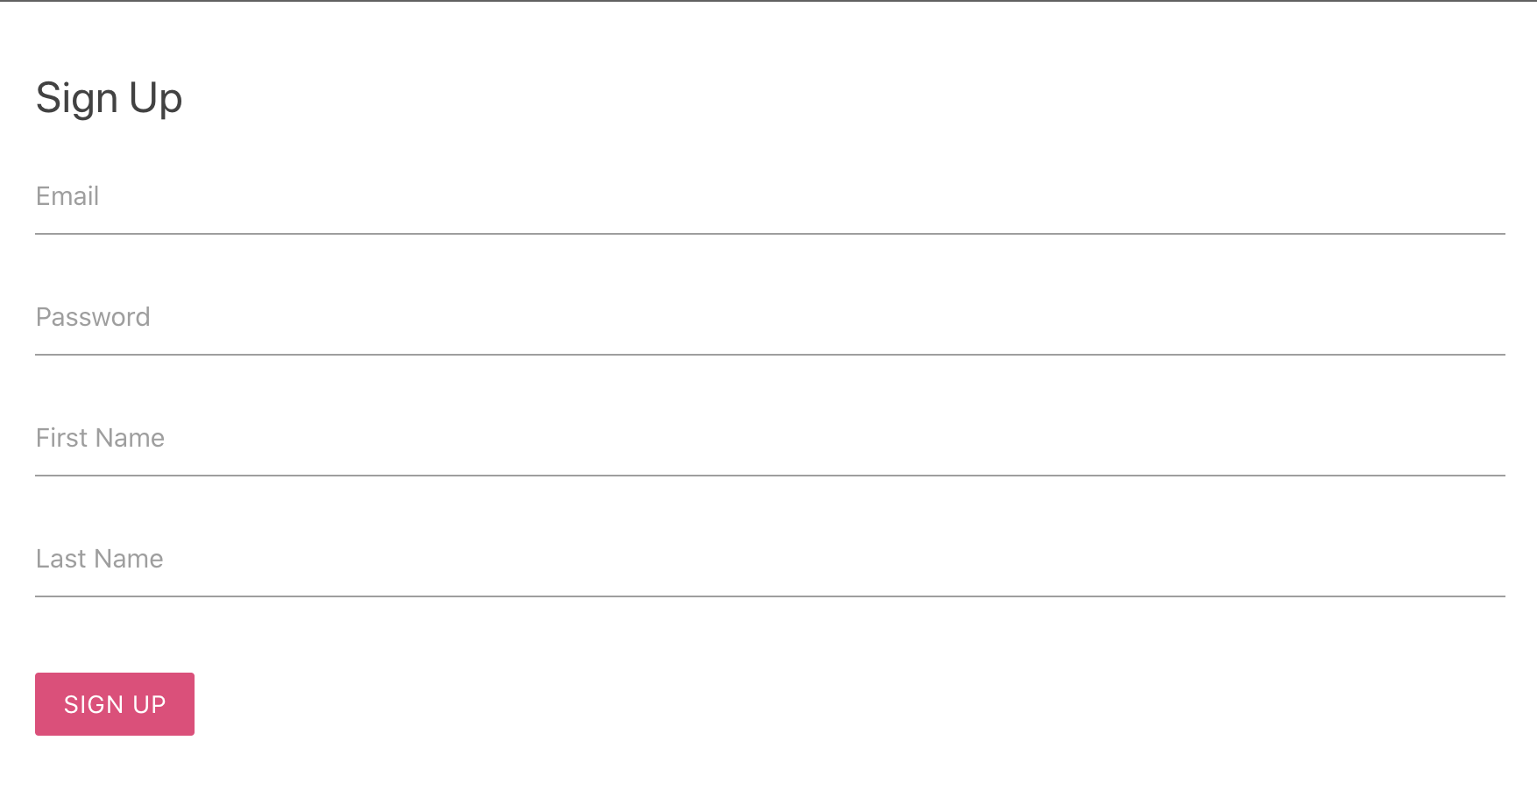
Sign Up/Login
In order to get the best out of our website you need to register
We wanted to have users create posts that can help out the community that is in search or supplies or just needs helpful information.

Slide 12
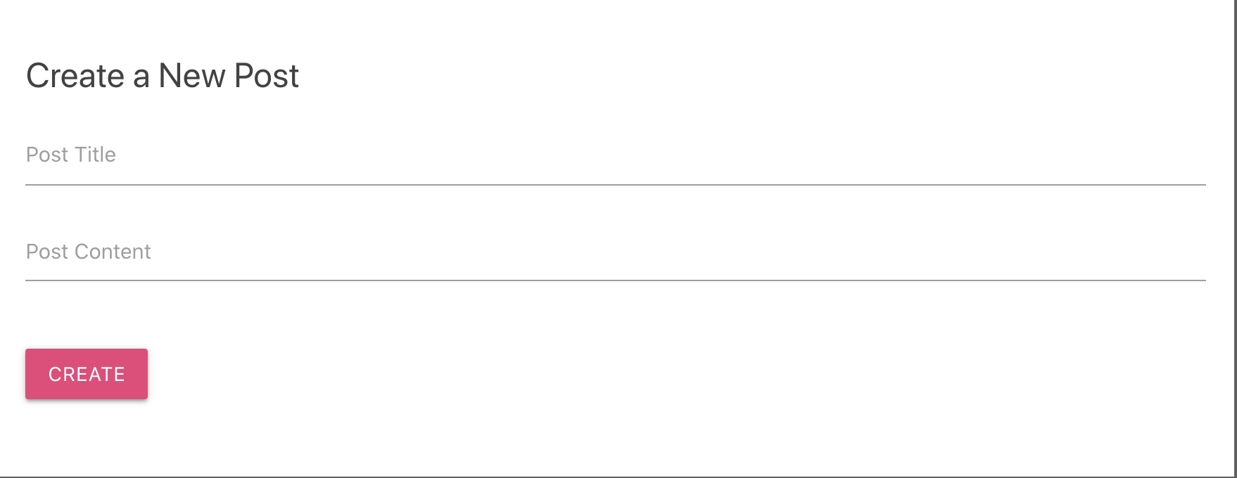
Creating Main Posts
Once the user has registered you can create a new main post with a title and content information by clicking on New Post on the navbar.

Slide 13
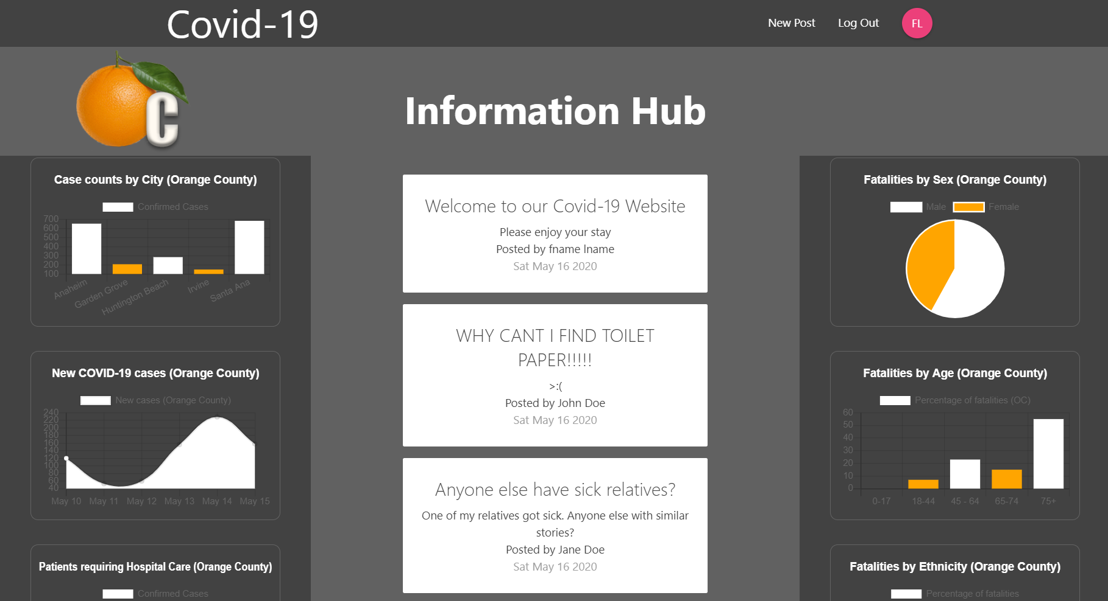
Main Posts
All main posts are displayed on the information hub.

Slide 14
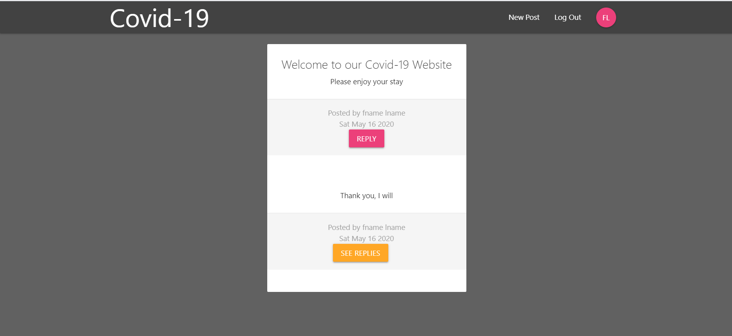
Post Details Page
Clicking on a main post in the homepage takes you to that posts page.
There you can see existing replies and reply to the post yourself.
*Due to time constraints replies only show up after clicking Reply button at least once to render the components

Slide 15
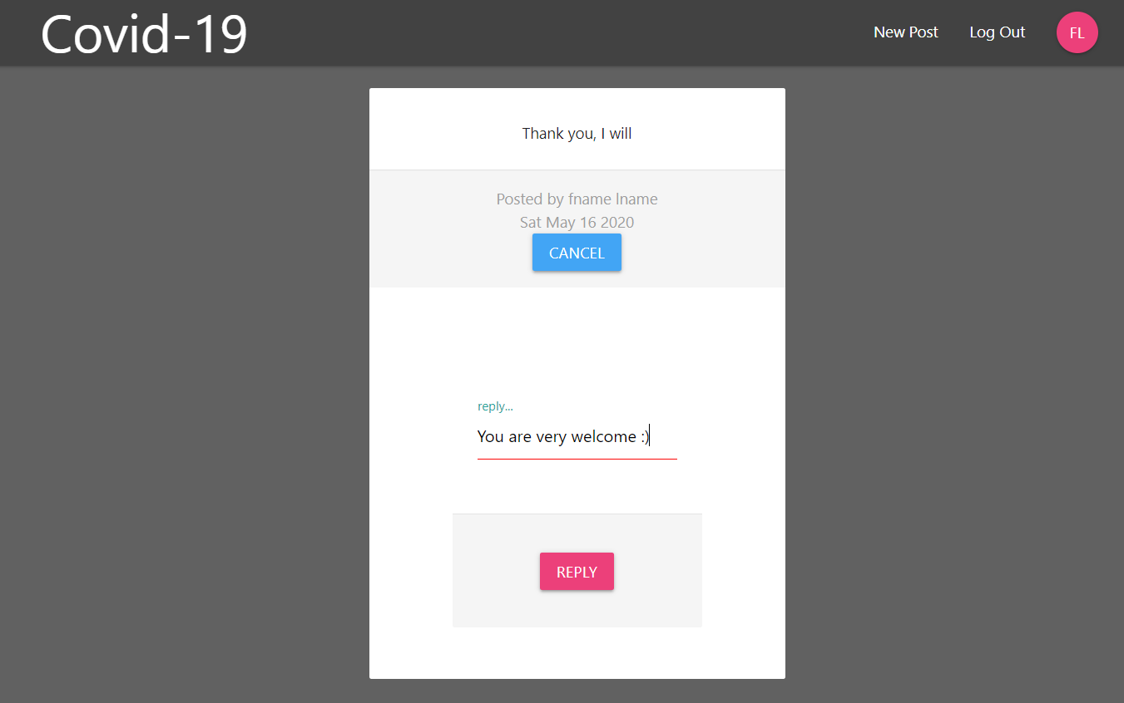
Replies
Replies unlike main posts do not have a title but they remember their parents.
Clicking See Replies takes you to that Reply’s page allowing you to Reply to the Reply or see other replies.

